Slide 1
ODMAP
Gaining Agency Access

Slide 2
HIDTA’s Overdose Detection Mapping Application Program – ODMAP, assists public health, fire, emergency medical service and law enforcement agencies track known and suspected overdose incidents . ODMAP helps decision makers develop strategies and tactics to reduce overdose occurrences.
The Washington/Baltimore High Intensity Drug Trafficking Area (W/B HIDTA) developed ODMAP to offer to first responders and government agencies free-of-charge.
Notes:
Mention how the ODMap was created.

Slide 3
Gaining Agency Access
To gain access to ODMAP your Agency needs to provide the following information when using the link on:
http://www.hidta.org/request-agency-access/
Required information:
Agency Name
Agency Type
(state, local, federal, or tribal)
Agency Identifier - not a required field
State
County - not a required field
Signor Name
Signor Title
Signor phone
Signor email
This will initiate the electronic Participation Agreement Process.
Also required to enter:
Admin name
title,
phone
e-mail
Notes:
To gain Agency Access the Agencies must make first contact.
This will then result in the email with the link to the Teaming Agreement
Will be sent. Stress that they should follow the instructions.
Point out the contact information to the class.

Slide 4
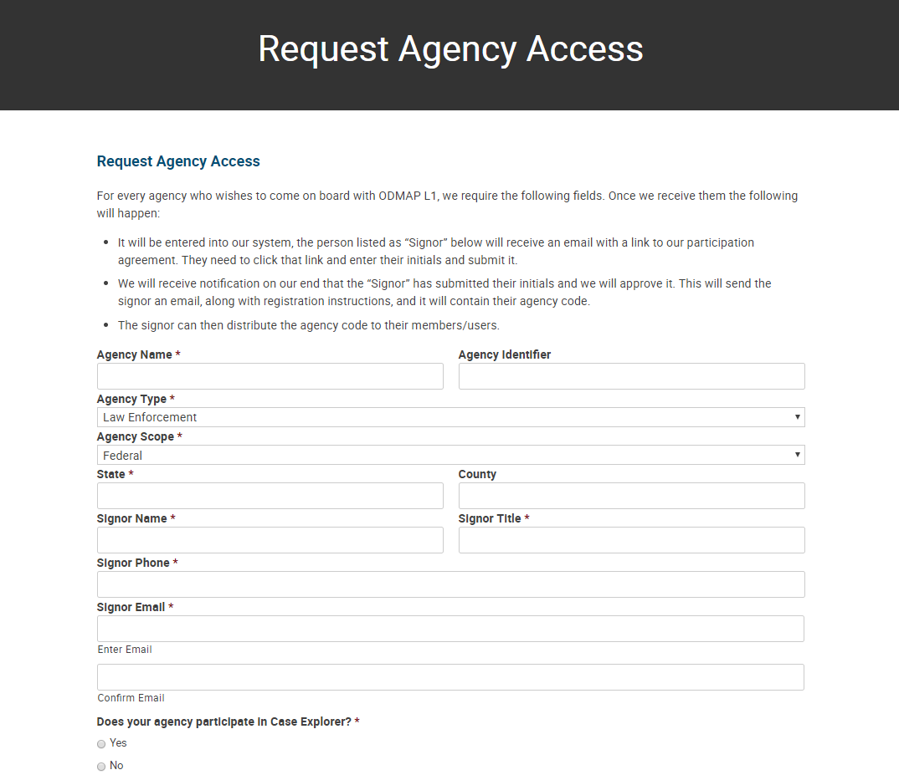
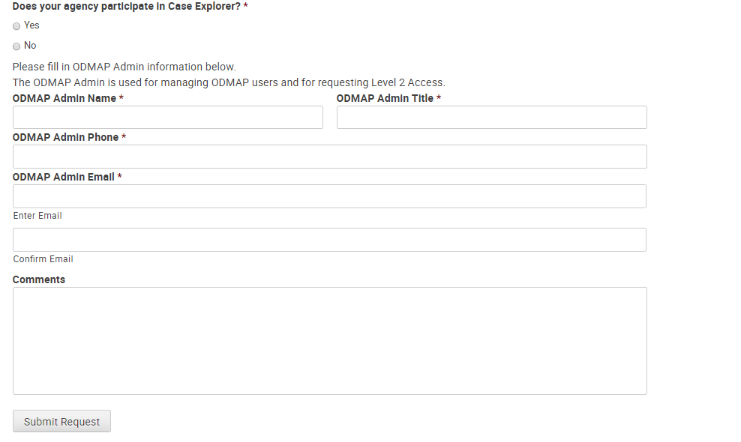
Gaining Agency Access
Gaining Agency Access (Cont’d)

Slide 5
Gaining Agency Access (Cont’d)
Upon approval, you will receive an email with:
Your Agency Code
Templates (2) to provide registration instructions to your staff
Template for ODForm users
Template for Fire/EMS and other partners
Notes:
After submission the email with the approved Team Agreement will go out to the Agency’s POC.

Slide 6
Gaining Agency Access (Cont’d)
You will receive an Agency approval email with the Agency Code
From: "odmap@wb.hidta.org" <odmap@wb.hidta.org> Date: Tue, Jan 16, 2018 at 9:16 AM -0500 Subject: ODMAP Agency Code To: “Shumaker, Erik" <es@fauquirecounty.gov>
Hello Erik Shumaker, The participation agreement between W/B HIDTA and the Washington / Baltimore HIDTA has been approved. Your Agency Code is RXNHUR This code must be entered during the registration process in order for your agency's users to be able to use ODMAP. If your agency uses Case Explorer, your users can sign up through the Case Explorer interface if you want them to be able to send Overdose Case Data to Case Explorer using the ODForm in ODMAP.
Here is an example email you can send to those users with instructions.
LE user email Template
Fire/EMS/ Other partners email Template
Notes:
This email has the all important Agency Code. The POC or someone who is designated to perform that duty will convey the code to their Agency’s users.
The icons will allow the instructor to hyperlink to the slide that correspond to the users that they are teaching for that session.
These are Templates that are provided to the POC to save them the time necessary to create a email to send the code out to their users.

Slide 7
Gaining Agency Access (Cont’d)
The template to use with a Law Enforcement/ODFORM user
Subject: Register for ODMAP through Case Explorer Body: W/B HIDTA is now a part of the Overdose Detection Mapping Application Program (ODMAP). As part of this program, we will be using ODMAP to capture Overdose Case Data and send it to Case Explorer. To facilitate this, you must register through Case Explorer using the following Agency Code: RXNHUR Please follow the instructions below. Instructions to Register for ODMAP through Case Explorer To create an account, you must click on the Your Profile link in the CE navigation menu. Below your profile information, there is an ODMap Account section. ODMap will use the Case Explorer profile information to register your ODMap account. Your ODMAP username will become the email address that is listed in your profile. You must enter a desired password and the agency code. You are required to agree to the terms in the Policies and Procedures documents for both Case Explorer and ODMap. Once those steps are complete, you may click the CREATE ODMAP ACCOUNT button. The account will automatically be created and will automatically be linked to your Case Explorer account. When you register for an ODMap account, an automatic email notification will be sent to any administrator of your default Case Explorer role. To login to ODMap, navigate to the site: https://odmap.hidta.org
Click to advance to the next slide
Notes:
This is the slide that has the email Template for Case Explorer users.
There is also a hyperlink to take the instructor to the next slide that they need and not to the Template for NON Case Explorer user. Of course if you are training a mixed class the instructor will want to advance to the NON Case explorer Template.

Slide 8
Gaining Agency Access (Cont’d)
The template to use with a Fire/EMS or other Partner
Subject: Registering for ODMAP Body: W/B HIDTA is now a part of the Overdose Detection Mapping Application Program (ODMAP). To begin entering Overdose’s into ODMAP, you must register first using the following Agency Code: RXNHUR Please follow the instructions below. To create an account, please go to https://odmap.hidta.org and click the REGISTER A NEW USER link. You will be taken to the User Registration page where you must enter all of the information requested, including your agency code. After you have read through the Policies and Procedures for ODMAP, click the Register button at the bottom of the screen. Please note, the button will only appear after you have reviewed the Policies and Procedures. Once you have registered, you will receive an email with a link that will confirm your registration with ODMAP. Clicking this link will take you back to the ODMAP site where you can login and start entering data.
Click to advance to the next slide
Notes:
This is the slide that has the email Template for NON Case Explorer users.
There is also a hyperlink to take the instructor to the next slide that they need.
Of course if you are training a mixed class the instructor will not want to use this hyperlink.

Slide 9
Contacts for Questions
HIDTA HELP DESK Days: Monday to Friday
Hours: 8:30 to 4:30 Est. Phone: 301 489-1744
For any questions regarding using the ODMap Program or registration, please contact:
ODMap Program Manager Aliese Alter (301) 489-1754
aalter@wb.hidta.org
or ODMap Coordinator Deb Flores (301) 489-1702
dflores@wb.hidta.org
Notes:
Stop here if you are just teaching how to gain Agency access.

