Slide 1

Overdose Detection Mapping Application Program (ODMap)
Washington/Baltimore HIDTA

Slide 2
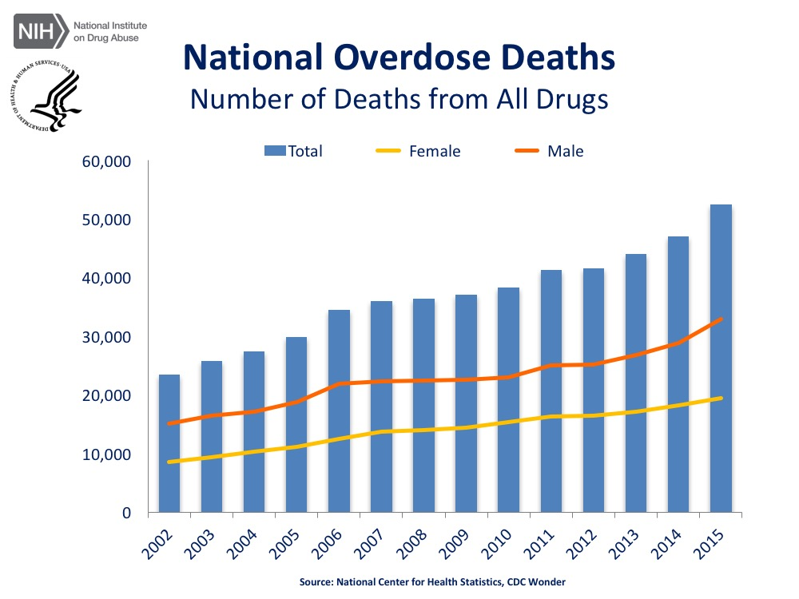
Overdose Epidemic
Nationally, over 52,000 overdose deaths were reported in 2015
All but 9 states have recorded an increase in overdose death rates from 2014 to 2015
Preliminary data from 2016 shows another anticipated and significant increase

Slide 3
ODMap Concept
ODMAP provides real-time overdose surveillance across jurisdictions to support public safety and public health efforts to mobilize immediate responses to overdose spikes
It links first responders on scene to a mapping tool to track overdose spikes as they happen for response and strategic analysis
It is designed to show spikes across multiple jurisdictions
It is a mobile site that can be used in the field via any mobile device or mobile device terminal, or data can added later from any computer
Partnering agencies sign a Teaming Agreement outlining policies for system use to protect the data being reported
The general public does not have access to this system

Slide 4
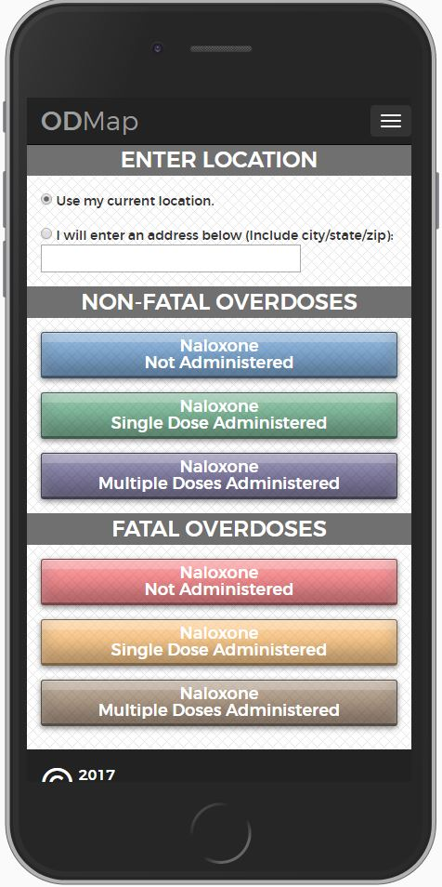
Data Intake Interface – Level I user
Data is entered into the system by a Level I user, defined as an officer or fire/EMS provider on scene or reported to a central location to be entered into the system
The Level I user makes a determination as to whether the incident/victim is fatal or non-fatal and the number of doses of Naloxone administered on scene
The Level I information is submitted to a central database and mapped to an approximate location
The Level I user does not collect any personal identifying information on the victim, nor is the data stored in the central database

Slide 5
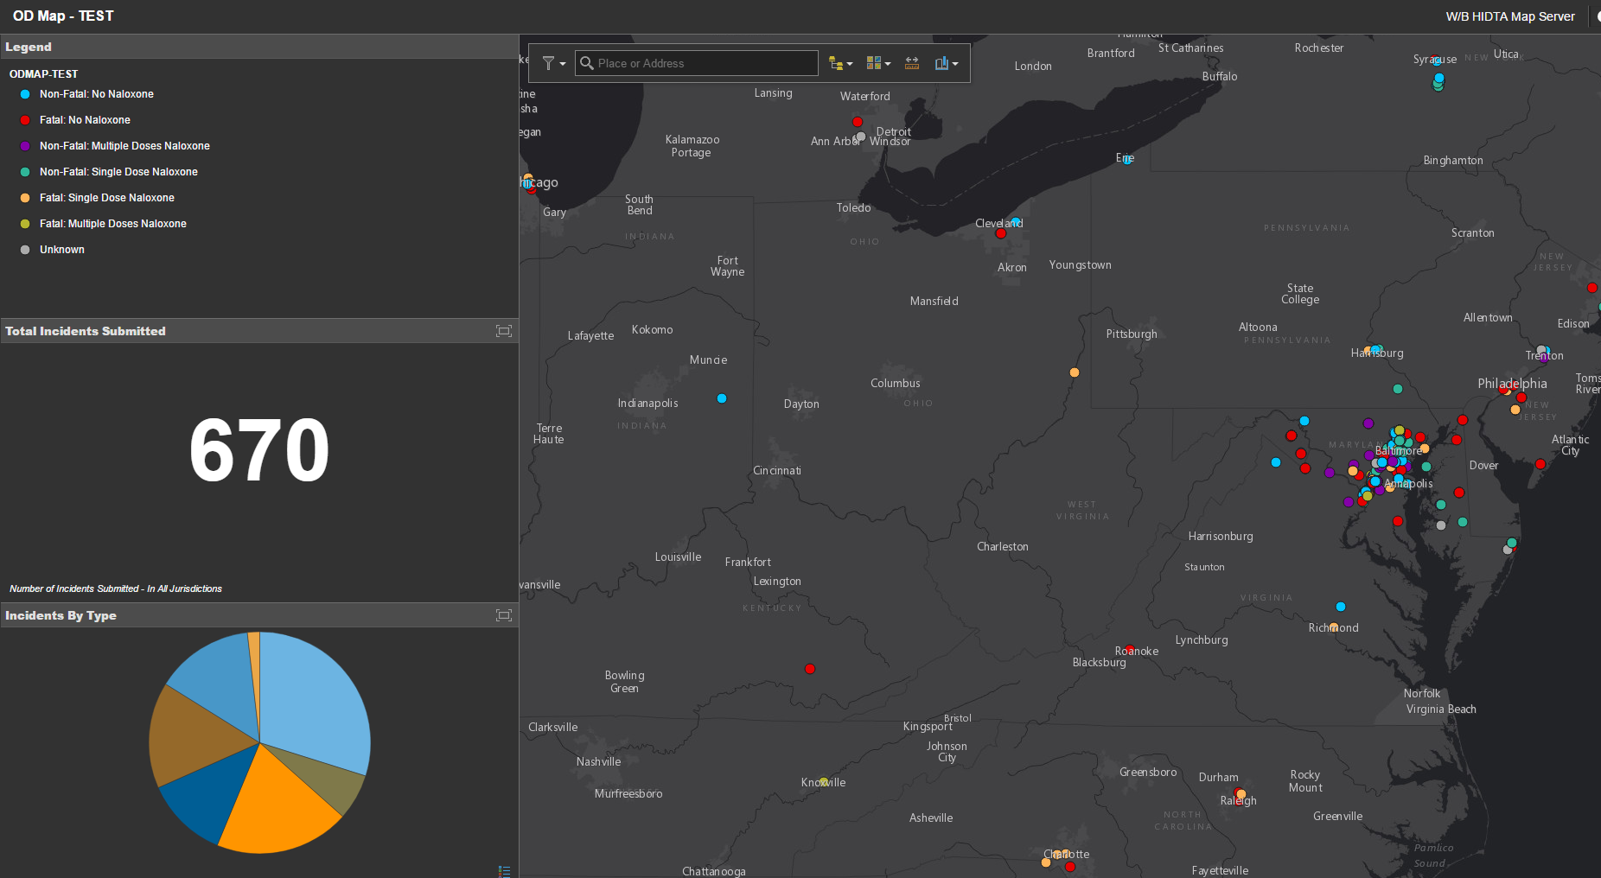
ODMap Interface – Level II User
The Level II must request and be granted a login credential to access the central database and map which captures the approximate locations of the overdoses as reported by the Level I user
Level II users are public health and public safety officials and analysts
The general public does not have access to this system
There are advanced search and filtering features in the system for analysis purposes

Slide 6
Spike Overdose Analysis
We evaluate counties and isolate a baseline to alert for overdose spikes within a 24-hour period

Slide 7
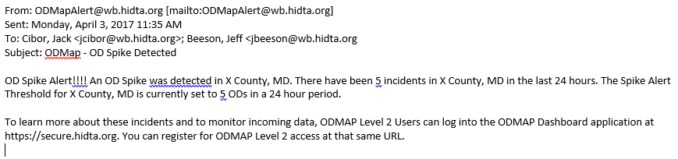
Spike Alert System
ODMAP is designed to alert Level II users when an overdose spike occurs in real time
Level II users can receive a spike alert within their jurisdiction or surrounding jurisdictions
It is intended to give the public safety and public health community real time alerts to mobilize a response strategy

Slide 8
W/B HIDTA Region – Pilot Phase
There was a four county pilot between 1/18/17 and 3/30/17
  Two Counties are contributing data through Fire/EMS
  One County is contributing data from the County Police Department
  One County is collecting data at a centralized Task Force Operation
We confirmed over 300 overdose incidents during the pilot phase and successfully instituted the overdose spike alert system
We recorded two confirmed overdose spikes and shared the information with public health and first responders
We also identified a spike that initiated a public safety response linking overdoses to a known drug trafficking organization

Slide 9
ODMap National Integration
ODMap is currently live in 10 counties nationally.
April will be the first month that we open the system to entities beyond Maryland and West Virginia
Any interested entities should contact:
Jeff Beeson, Deputy Director W/B HIDTA
jbeeson@wb.hidta.org
301-489-1734

