Slide 1


ODMAP
Level 1
How to register and use the app
for Law Enforcement users?

Slide 2

  Level I vs. Level II Access
ODMAP provides two levels of access:
Level I participants are granted authority to submit known and suspected overdose event data using ODMAP.
Level II participants are those granted access to the ODMAP dashboard, which allows the user to view all data, nationwide, submitted via ODMAP.
Some agencies may have Level I and Level II users, while others may only have Level I or Level II users

Slide 3

ODForm: PII is not stored on the ODMAP server for HIPAA reasons. Rather, we have made ODForm And the ability to enter and store data an option for our LE partners.
ODForm is part of the ODMAP process, but data would be stored on our CE Server. The following slides provide instructions on how to ODForm.

Slide 4
  How do I get my Agency Code?
Level I users should get their agency code from their agency head or designee. If they do not have this, they can contact the Help Desk to find out the Agency Code.
HIDTA HELP DESK Days: Monday to Friday
Hours: 8:30 to 4:30 Est. Phone:301 489-1744

Slide 5
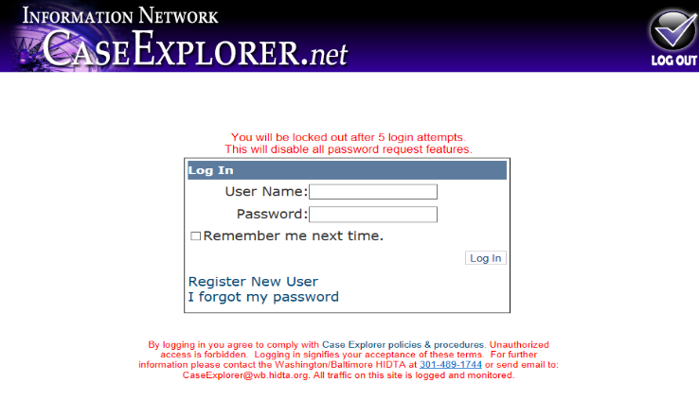
  Registering
Case Explorer users MUST register their ODMAP account in Case Explorer.
This step ensures the accounts are linked.
Login to your Case Explorer Account

Slide 6
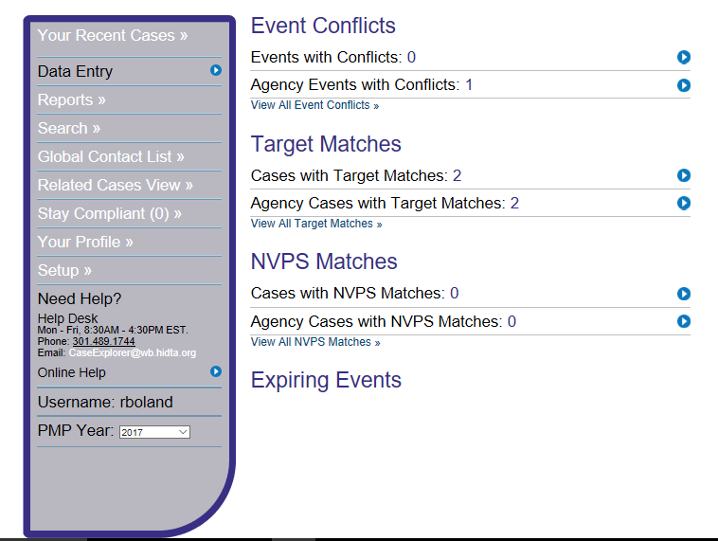


  Registering (Cont’d)
Go to:
The Navigation Panel
Select:
“Your Profile”
Notes:
Go to the Case explorer Home page
Navigation Panel
Select Your Profile
Scroll down on the Profile page and there they will find the ODMap
Registration.
The users MUST have the Agency Code.
During the initial rollout, the users will call the Help Desk. Once POC for each Agency are identified the user will contact their Agency’s POC to get the code.
301 489-17744
Hours 8:30 am to 4:30 pm
CaseExplorer@wb.hidta.org

Slide 7
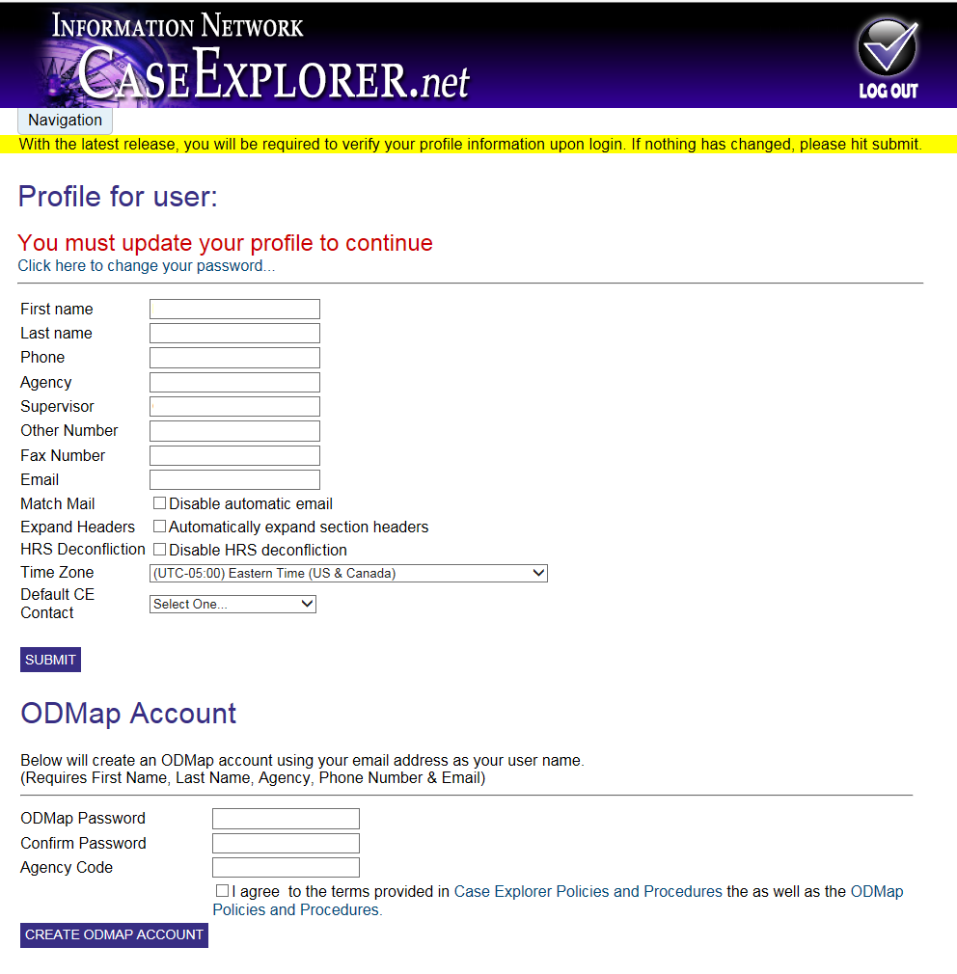
  Registering (Cont’d)
Scroll to the bottom of the “Your Profile” page to create an ODMAP account.
Once you’ve clicked “Create ODMAP Account,” wait for the account activation email before trying to log into the ODMAP.
Notes:
Go to the Case explorer Home page
Navigation Panel
Select Your Profile
Scroll down on the Profile page and there they will find the ODMap
Registration.
The users MUST have the Agency Code.
During the initial rollout, the users will call the Help Desk. Once POC for each Agency are identified the user will contact their Agency’s POC to get the code.
301 489-17744
Hours 8:30 am to 4:30 pm
CaseExplorer@wb.hidta.org

Slide 8
How do I use
ODMAP Level I ?
Notes:
How do I use the ODMap Level One?

Slide 9
  Devices
ODMAP works on Windows, Android, iOS, and OS X based devices with a standard browser including Chrome, Firefox, and Safari.
ODMAP Level I can be used in the field or in the office from any mobile device, mobile device terminal, or desktop computer.
Some features require location services and cookies to be turned-on.
Notes:
The application is a web site that works on Windows, Android, iOS, and OS X based devices with a standard browser including Chrome, Firefox, and Safari. Some of the features require that location services and cookies be turned-on.
If using a Windows or Apple computer that is not GPS capable, it is recommended that an address is given to determine the location.

Slide 10
  ODMAP Level I Login Page
https://odmap.hidta.org
Notes:
The link to the ODMap.

Slide 11
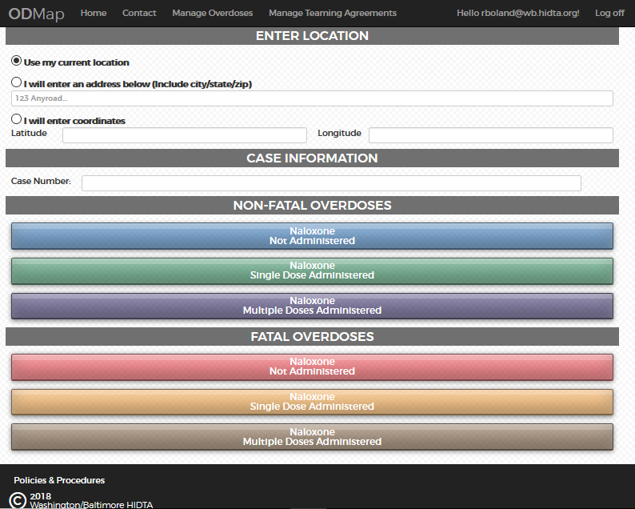
  Entering an Incident
Users will enter:
Overdose incident location
Case number (optional)
Type of overdose
After submission, the user will be able to add additional incidents.
Notes:
Here users will find the 3 ways to enter their data and the 3 Non-Fatal and 3 Fatal choices.
Use my Location
I will enter an address
Latitude & Longitude
Once the entry has been submitted, the user will be able to add additional victims.

Slide 12
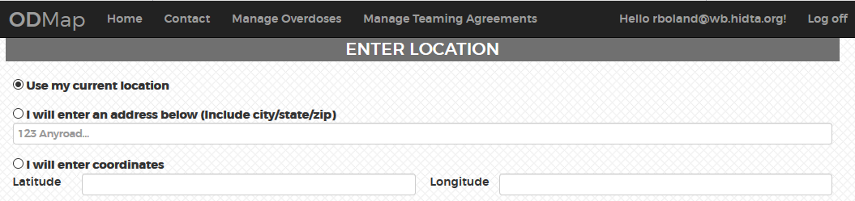
  Entering an Incident Location
Users can enter a location in three ways:
1. Use my current location
2. Enter an address (Must include city, state, and zip code)
3. Latitude & longitude (Must input at least 5 decimal places).
Ex. -76.47508 39.03452
Notes:
Users may select to enter the point via:
1. Use my location
2. I will enter my address
City-State-Zip
3. Latitude & Longitude require level of precision you must input up to 5 digits
Ex. -76.4758 39.03452

Slide 13

  Using “My Current Location”
If using “use my current location” note that once an overdose type is selected the incident is automatically submitted.
If using a Windows or Apple computer that is not GPS capable, it is recommended that an address is entered to input the location of the incident.
Notes:
The application is a web site that works on Windows, Android, iOS, and OS X based devices with a standard browser including Chrome, Firefox, and Safari. Some of the features require that location services and cookies be turned-on.
If using a Windows or Apple computer that is not GPS capable, it is recommended that an address is given to determine the location.

Slide 14
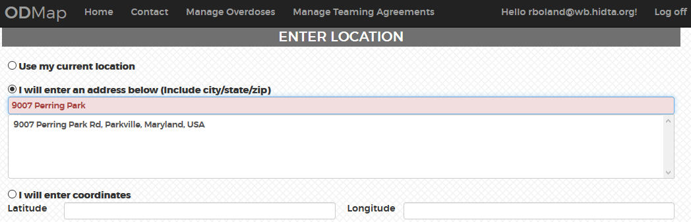
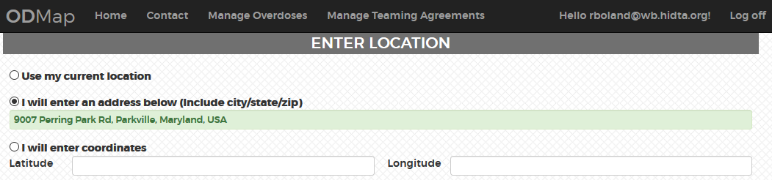
  Using “I will enter address below”
You must select the full address displayed below the data entry field.
The data entry field will then turn GREEN.
Notes:
Point out when keying in your address be sure to select from the addresses displayed below the data entry field.

Slide 15
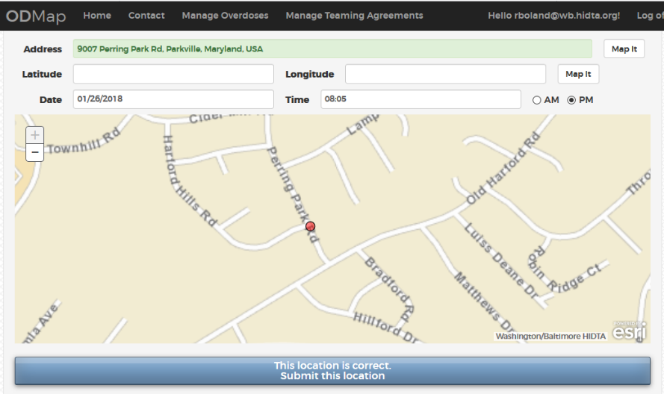
  Confirming the Location
Clicking the “Map it” Button allows the user to view the location before submitting.
Notes:
The user should click the MAP IT button when they are sure the location is correct.
Users can’t remove in correct points. They must contact the Help Desk and submit a ticket.
HIDTA Help Desk Contact information:
301 489-17744
Hours 8:30 am to 4:30 pm
CaseExplorer@wb.hidta.org

Slide 16
  Filling in the Date & Time
The date and time fields automatically show the current date and time. The user may edit the date and time prior to submitting the incident.
Notes:
At the top of the page: fill in the Date and Time then click- This location is correct submit this location.

Slide 17
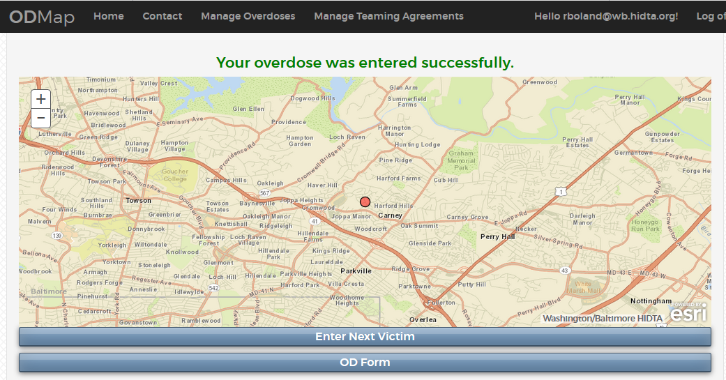
  Successful Submission
The overdose was entered successfully.
The user can enter another incident or complete an “ODFORM”.
Notes:
The overdose was entered successfully.
The user can select between entering another Victim.
Case Explorer users have the ODForm as an option.

Slide 18
  ODForm
  ODForm cannot be used until the point is submitted to ODMAP.
  Data entered into ODForm is not stored in ODMAP. It is sent to Case Explorer.
  No PII is stored in ODMAP
Notes:
ODMAP Form Entry cannot be used until the point has been submitted to the ODMap.

Slide 19
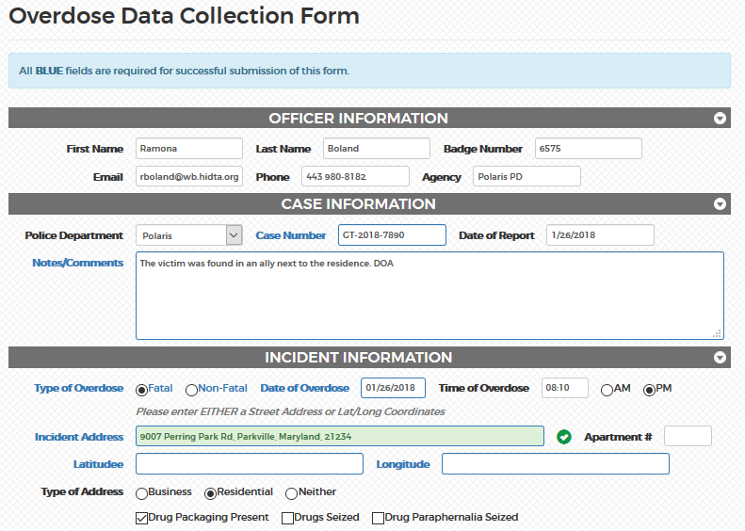
  ODForm (Cont’d)
Fields marked in bold blue are required for submission
Notes:
The advantage of using the ODForm is the user will have more case information in the system. Using ODForm puts the case in the user’s recent cases in Case Explorer.
Fields marked in BOLD Blue are required for submission.

Slide 20
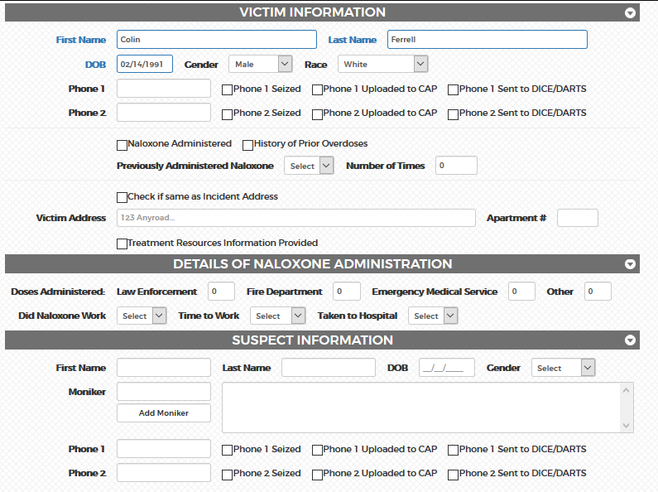
  ODForm (Cont’d)
Fields marked in bold blue are required for submission
Notes:
The advantage of using the ODForm is the user will have more case information in the system. Using ODForm puts the case in the user’s recent cases in Case Explorer.
Fields marked in BOLD Blue are required for submission.

Slide 21
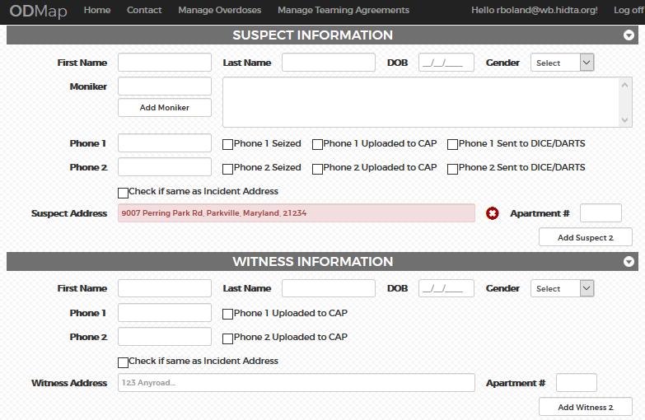
  ODForm (Cont’d)
Notes:
The advantage of using the ODForm is the user will have more case information in the system. Using ODForm puts the case in the user’s recent cases in Case Explorer.
Fields marked in BOLD Blue are required for submission.

Slide 22
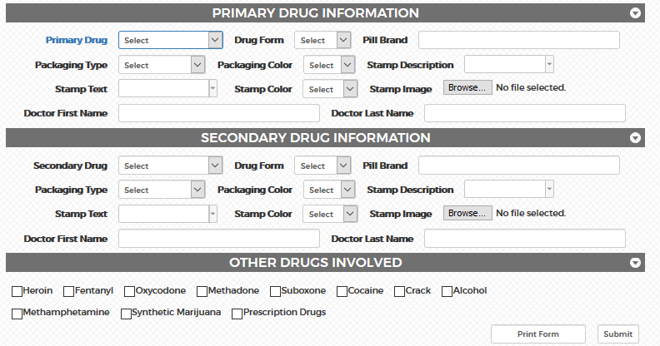
  ODForm (Cont’d)
Fields marked in bold blue are required for submission
Notes:
The advantage of using the ODForm is the user will have more case information in the system. Using ODForm puts the case in the user’s recent cases in Case Explorer.
Fields marked in BOLD Blue are required for submission.
User can also now print directly from the ODForm prior to submitting the ODForm.

Slide 23
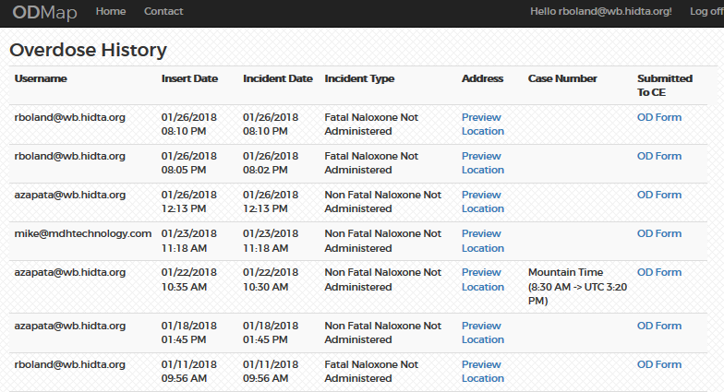
  Manage Overdoses
Users or administrators can manage their overdose submissions by clicking Manage Overdoses. Case Explorer users will find their submitted ODForms under their recent cases.
Administrators can view all ODForm submissions from all users in their role.
Notes:
Users can manage their Overdose submissions by clicking Manage Overdoses.
Case Explorer users will find their submitted ODFORMs under your recent cases.
Admins can view all ODForm submissions from all users in their role.

Slide 24
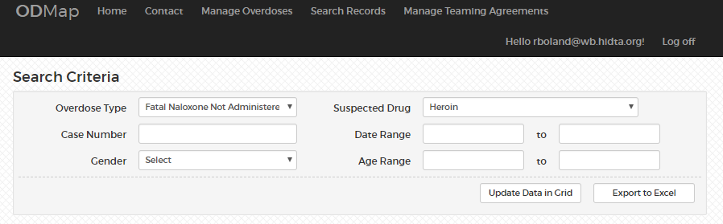
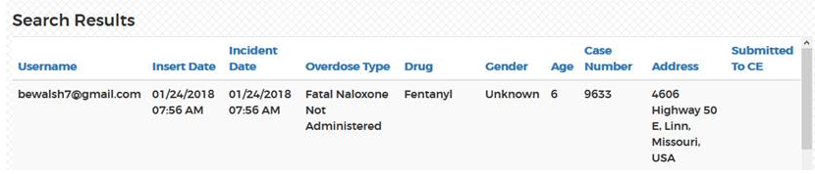
  Manage Overdoses (Cont’d)
All users will now be able to get to the Manage Overdoses link and there is a Search Records feature.

Slide 25
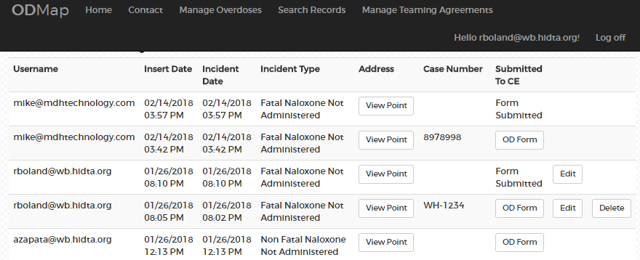
  Manage Overdoses (Cont’d)
When a user goes to the Manage Overdoses page they will now be able to Edit and Delete records.
A user can only edit a record if they created it.
A user can only delete a record if they created it AND the OD Form has not been submitted.

Slide 26
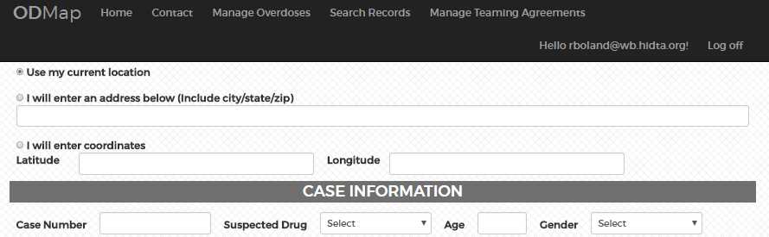
  Manage Overdoses (Cont’d)
You can now enter in a Case Number, Suspected Drug, Age and Gender when submitting a point on the main page.

Slide 27
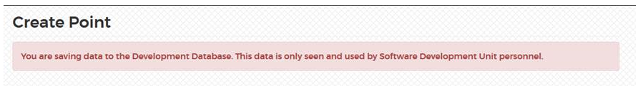
  Manage Overdoses (Cont’d)
Once a user submits a point from the main page, there will be a warning message to let them know that they are submitting a point to a live database.
This is in development, therefore the message is for development.

Slide 28
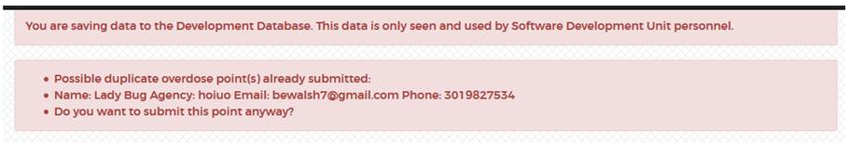

  Manage Overdoses (Cont’d)
Once a user clicks on the box verify the point is the correct one, the system will check for any existing overdoses that are within 50 feet and 2 hours of the overdose they are attempting to save.
If there are any matches (it matches on ALL records, not just the ones the user has submitted), it will return a warning message with the contact info from the other user(s) and asks if they still want to submit the point.
Click YES Submit this location
This same check occurs when a record is edited.

Slide 29
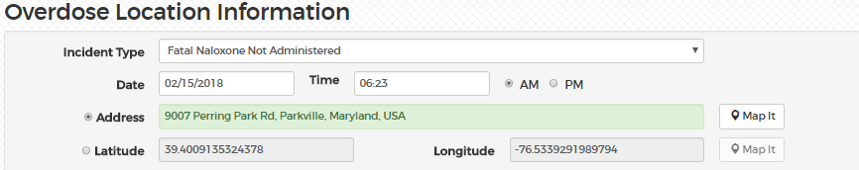
  Manage Overdoses (Cont’d)
Whether a point is submitted using an address or Lat/Long (this includes
Use My Location), they will only be able to edit that field. If they enter in an address, lat/long will be shown, but disabled and vice versa.
They may change which one is used, but the fields will be cleared and they will have to re-map it.

Slide 30
How do I configure my phone to use the app?

Slide 31

  Phone Configuration
Phone configuration is provided for popular devices. Configuration of other devices will be similar. If your model is not covered here, please consult the internet or your product manual.

Slide 32
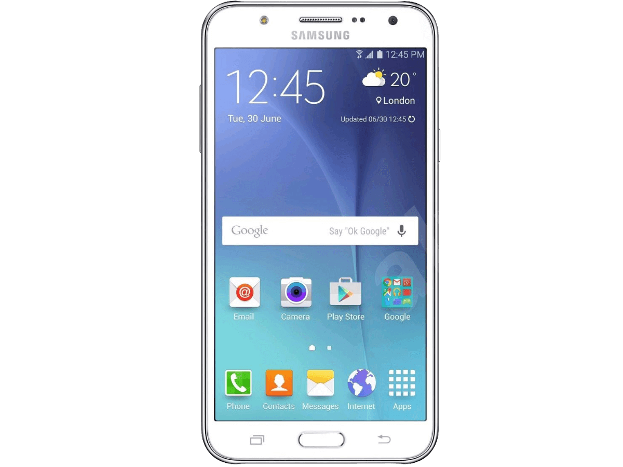
  Phone Configuration
Samsung Galaxy S7 with Android OS (and similar devices)
  Turning On Location Services
    Open the Settings App on your phone
    Scroll to and Select Location
    Slide the toggle to ON if it is not there already

Slide 33

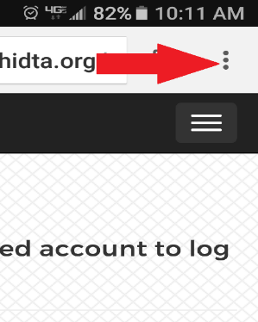
  Phone Configuration
  Setting the Chrome Browser to Accept Cookies
    Open the Chrome Browser
    Select the three dots/ellipsis in the top left corner of the Chrome window to open a menu

Slide 34
  Phone Configuration
    Select ‘Settings’
    Select ‘Site Settings’
    Under ‘All Sites’: Select ‘Cookies’
    Slide the toggle to the right to accept cookies if it is not already there

Slide 35

  Phone Configuration
iPhone 6 (and similar devices)
  Turning On Location Services
    Open the Setting App
    Select Privacy

Slide 36
  Phone Configuration
    Select Location Services
      Slide the toggle to the right to turn on Location Services
      In the list of apps that use location, select your browser
      Select ‘While Using’ to allow your browser to use location services while you are using your browser

Slide 37

  Phone Configuration
  Setting the Safari Browser to Accept Cookies.
    Open Settings App
    Scroll down to and select Safari
    Scroll down to and select ‘Block Cookies’
    Select ‘Allow from Current Website Only’

Slide 38
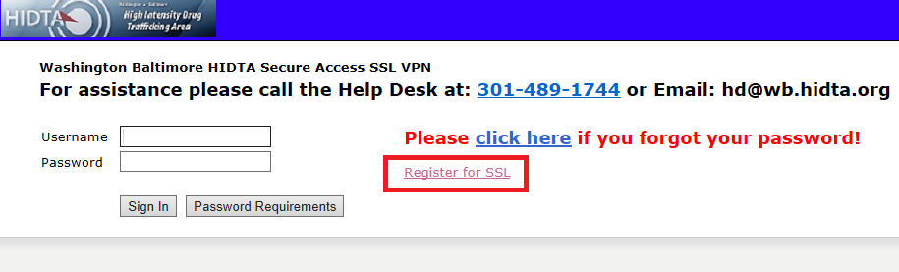
  Looking for Level 2
If you are looking for Level 2 access to the ODMap application go to:
https://secure.hidta.org
Click register for SSL account
Fill out the registration form requesting SSL and ODMap Level 2 access
Return the registration request via email.
Email to: Registration@wb.hidta.org
Your access information will be emailed to you.
Analytical Users

Slide 39
Contacts for Questions
HIDTA HELP DESK Days: Monday to Friday
Hours: 8:30 to 4:30 Est. Phone:301 489-1744
If you have any questions regarding the ODMap Program, please contact Jeff Beeson by phone: (301) 489-1734 or by email: jbeeson@wb.hidta.org
For any questions regarding user registration, please contact Kelly McCord by phone: (301) 489-1763 or by email: kmccord@wb.hidta.org

