Slide 1


Washington/Baltimore High Intensity Drug Trafficking Areas (W/B HIDTA)

Slide 2
What Can An Agency Administrator Do?

Slide 3
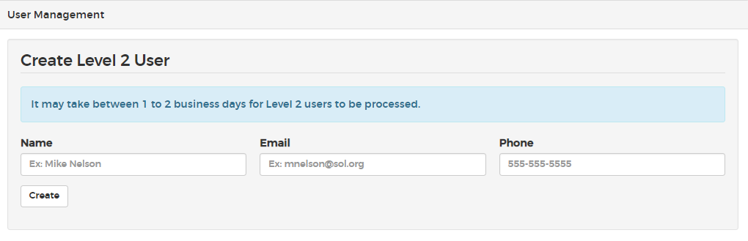
Add Additional Users
Assigned Administrator for an Agency can grant Level II access:
  Assigned Administrator will click on Manage>Your Agency in the Level I platform
  Click on “User Management” and click “edit”

Slide 4
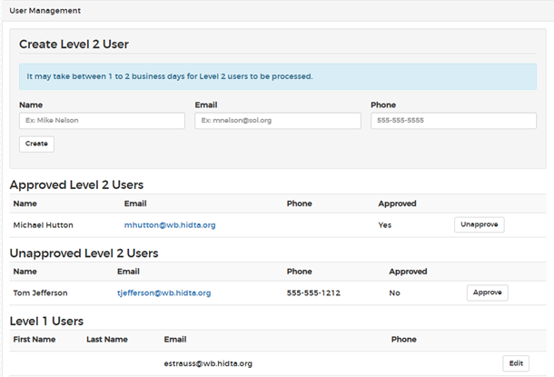
User Management
Assigned Administrator for an Agency can restrict Level II access:
  Assigned Administrator will click on Manage>Your Agency in the Level I platform
  Click on “User Management”
  Use the approve, unapprove, and edit buttons

Slide 5
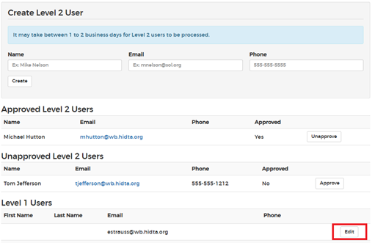
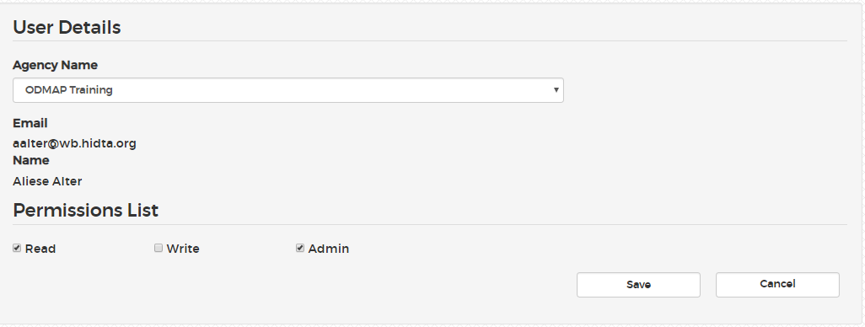
Grant/Restrict Permissions For Users
ODMAP administrators can set various permissions for Level I users in their Agency
  Click on Manage>Your Agency>User Management>Select desired user and click “edit”

Slide 6
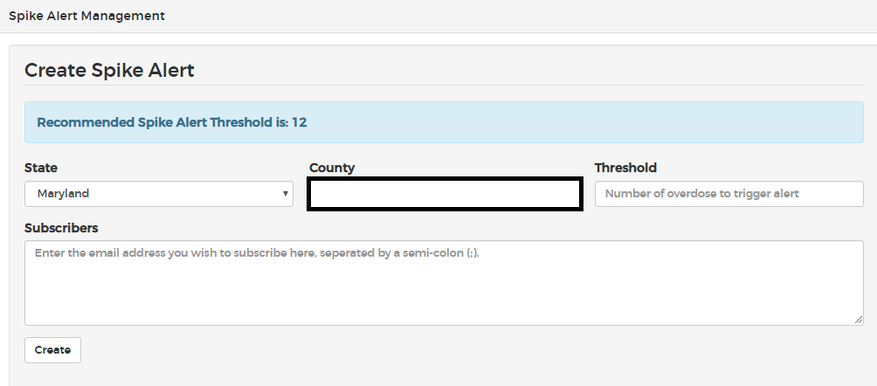
Adding Spike Alerts
Assigned Administrator will click on Manage>Your Agency>Spike Alert Management in the Level I platform
  You can set a threshold of your preference, or the system will suggest a recommended threshold based on the data entered into ODMAP
  The recommended threshold is based off on the formula of 2 standard deviations above the mean. Agencies that have not entered data (or much data) will be prompted with the default recommendation of 3

Slide 7
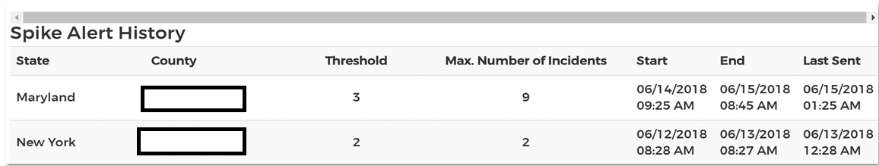
Spike Alert Management
Administrators can also view their spike alert history. This list provides information on prior spikes for the specified areas and includes additional detailed information.
  Assigned Administrator will click on Manage>Your Agency in the Level I platform

Slide 8

Jeff Beeson, Deputy Director
Washington/Baltimore HIDTA www.hidta.org/odmap
301-489-1734

