Slide 1

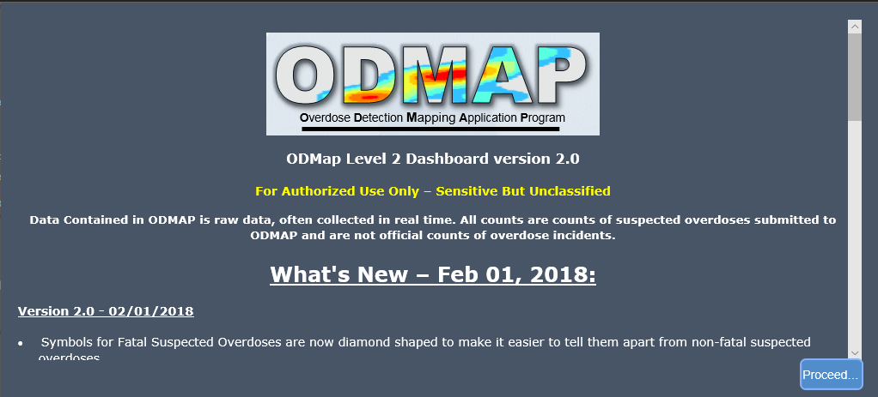
O
D
M
A
P
LEVEL II
Gaining access & using Level II

Slide 2

  ODMAP Dashboard
The ODMAP Dashboard is a web-based app designed to facilitate real-time surveillance of suspected overdoses. The dashboard provides Level II users the ability to display and filter locations of suspected ODs, entered by Level I ODMAP users, and can be used to identify clusters of suspected ODs and spikes in OD events.
The Dashboard component of ODMAP is designed to be used on
a laptop or desktop computer, and is not designed to be used on small mobile devices, but will work on devices as small as a phone.

Slide 3

Policy & Procedures
The ODMAP Policies and Procedures can be read online.
UPDATED AND PLACED ONLINE
  http://www.hidta.org/wp-content/uploads/2018/08/ODMAP-Policies-and-Procedures-CURRENTFINAL.pdf

Slide 4
Gaining access to ODMAP’s Level II

Slide 5

  Looking for Level II
Level 2 is for Decision Makers Analytical Users
If you are looking for Level 2 access to the ODMap application, ask your Agency’s ODMap Administrator.
ODMap Administrators can now grant their users access to Level II.

Slide 6
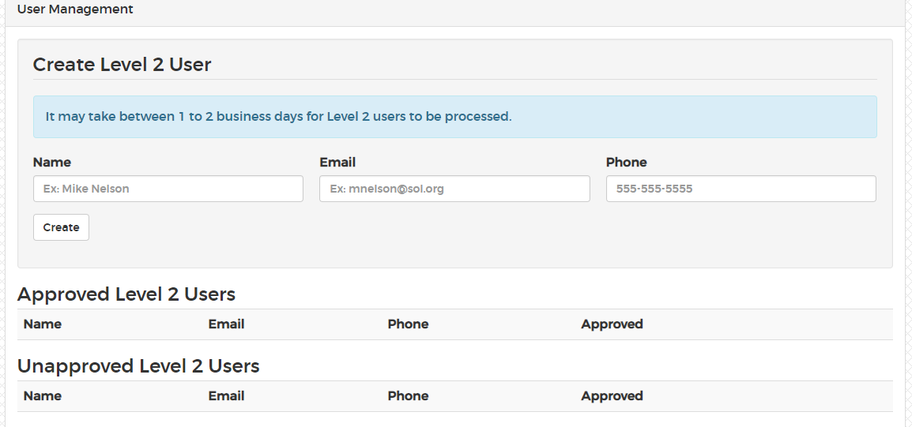
  Looking for Level II
GAINING ACCCESS TO LEVEL II:
Assigned Administrator for an Agency can grant Level II access:
  Assigned Administrator will click on Manage>Your Agency in the Level 1 platform
  Click on “User Management”
Level 2 is for Decision Makers Analytical Users

Slide 7
Logging into the ODMAP Level II

Slide 8
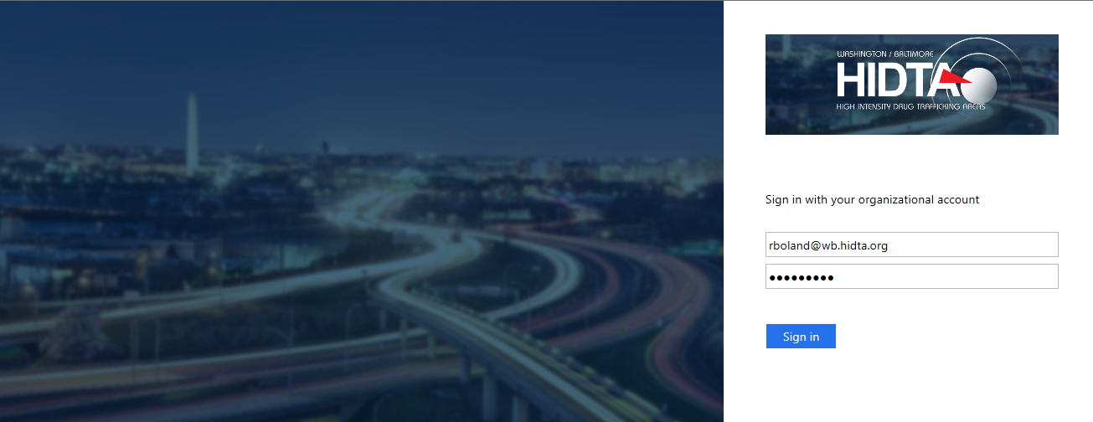
  ODMAP Dashboard
https://Odmapl2.hidta.org

Slide 9

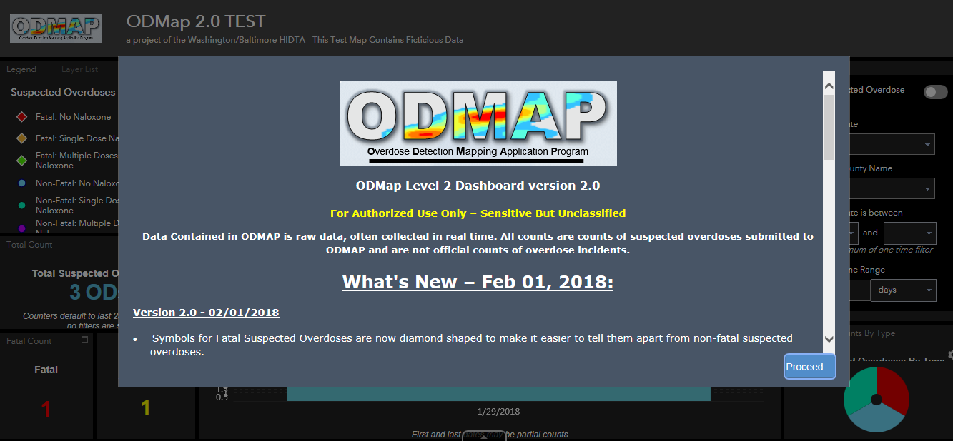
  ODMAP Dashboard (Cont’d)
What’s new to the ODMAP is shown on this page. Click PROCEED to exit.

Slide 10
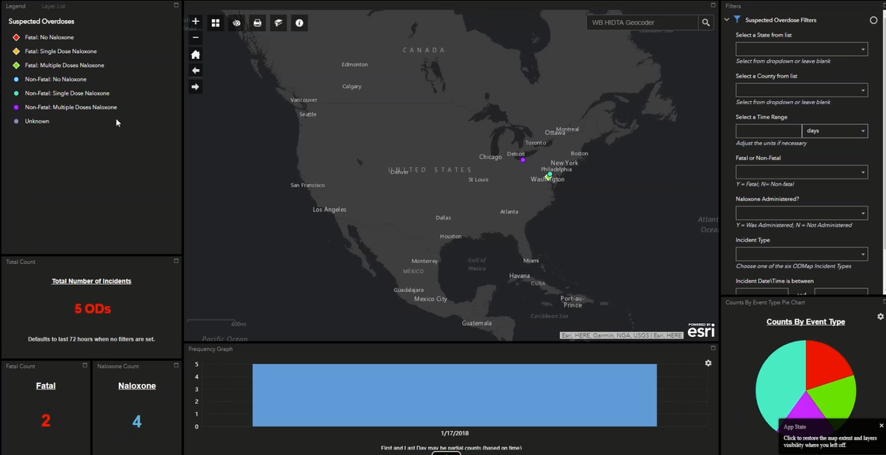
  Level II Features
This is the ODMAP Dashboard
- Initial view filters for last 24 hours
- Use the filter tools for other date & time ranges

Slide 11
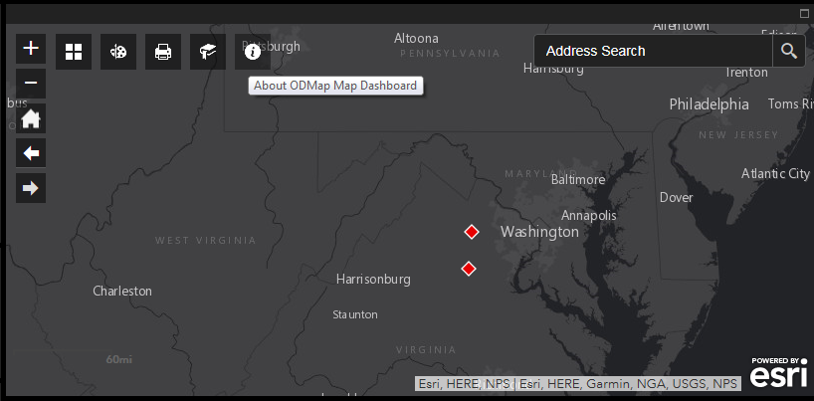
  ODMAP Tools
There are ODMAP tools located on the map area.
Hovering your cursor on the tool will tell you what the tool is.
Search by Address is in the top right-hand-corner.

Slide 12










  ODMAP Tools (Cont’d)
About ODMAP Dashboard
Zoom in
Bookmark
Zoom out
Print
Default Extent (Lower 48)
Draw
Previous Extent
Change Basemap
Next Extent

Slide 13
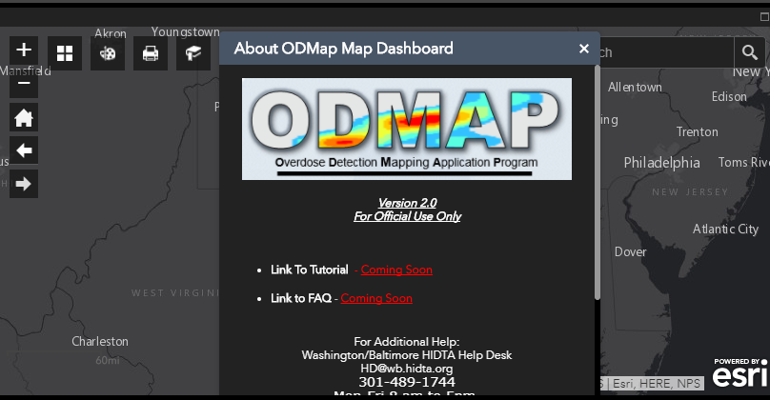
  ODMAP Information Tool

Slide 14
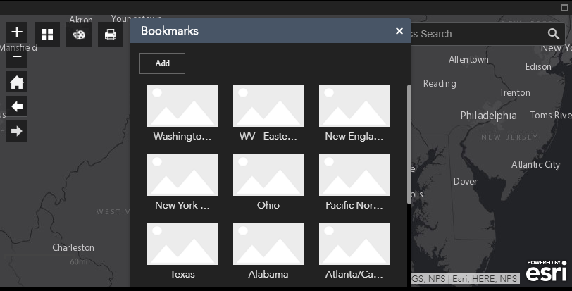
  Bookmark View
Bookmarks are used to zoom in to predefined areas

Slide 15
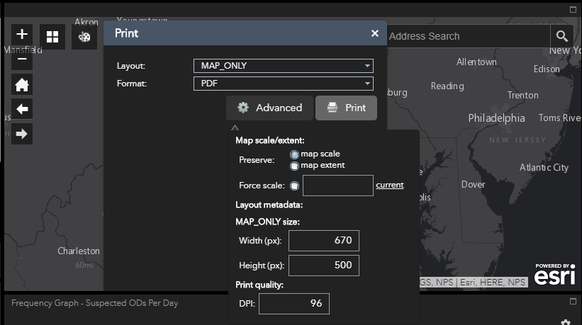
  Print View
The print function allows creation of a PDF that you can then print.

Slide 16
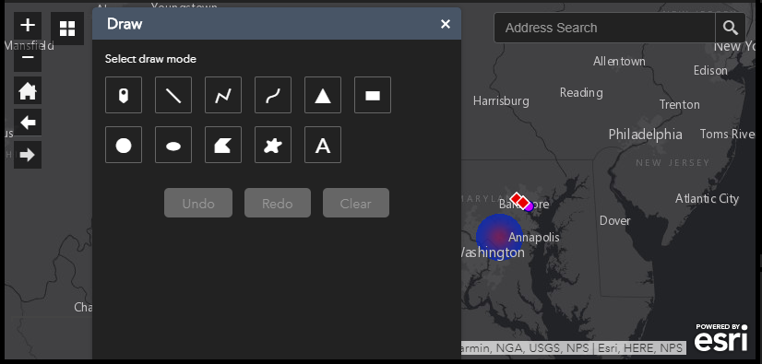
  Drawing View
Check out the many drawing tools. Drawing tool can be used to mark up a map prior to printing.

Slide 17
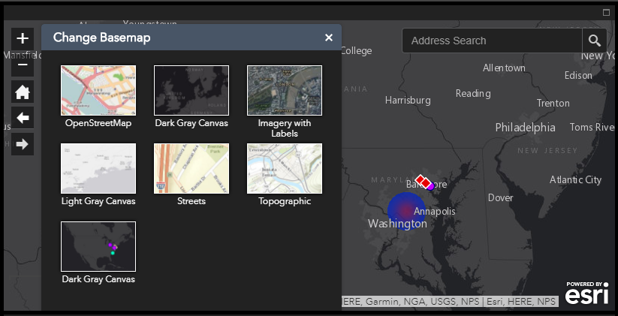
  Change Basemap View

Slide 18
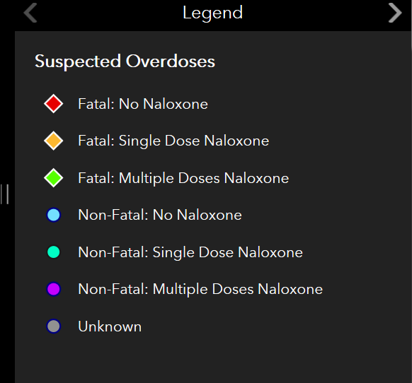
  Legend Features
Fatal overdoses are diamonds
Non-Fatal overdoses are circles
*Unknown overdoses denote automated submissions
that did not have a valid overdose type

Slide 19
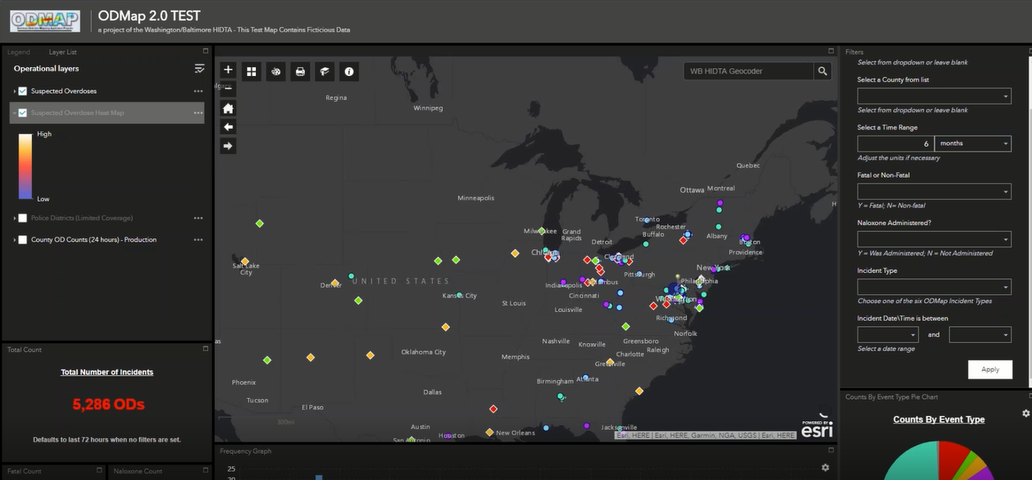
  Layer List
Select the Layer list to view
- Suspected Overdoses
- Heat Map
- Police Districts*
*Police districts can be added by submitting a request to the HELP DESK.

Slide 20
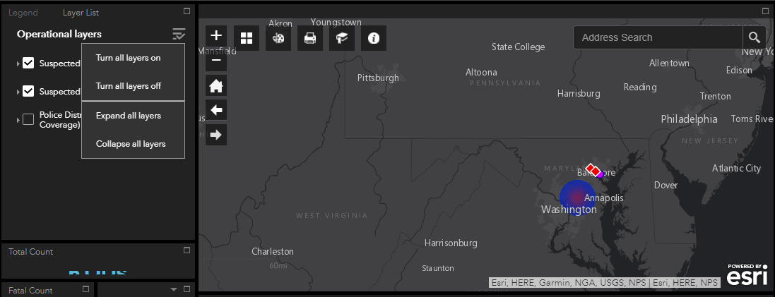
  Layer List (Cont’d)
This is the ODMAP Layer List view. The Heat Map has been checked.

Slide 21
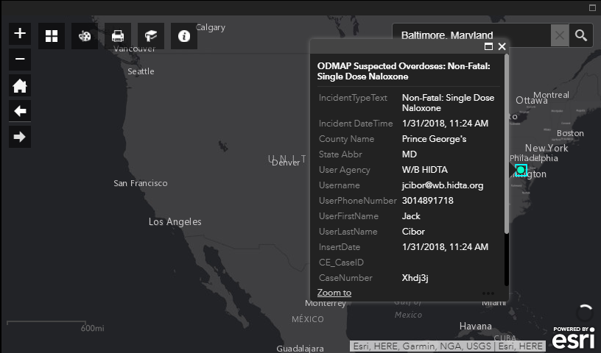
  Information Box
Clicking a dot on the map will open up an information box, seen in the picture below.

Slide 22
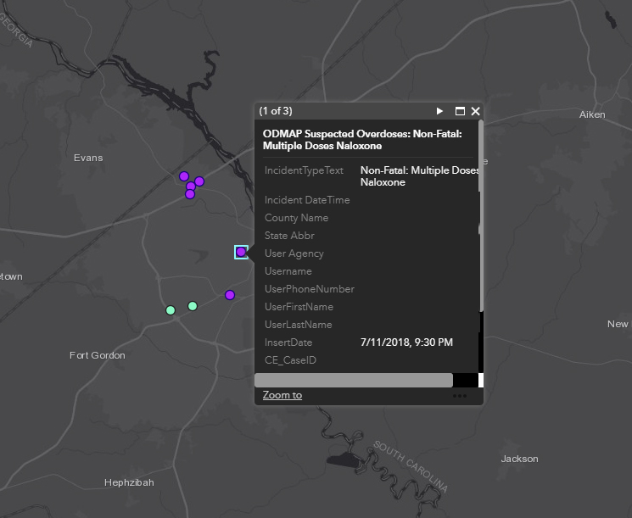
  Information Box (Cont’d)
Multiple Logged Overdoses at One Address
If there are more than one Overdose logged at one location, click on the point on the map and it will display all of the logged overdoses (ex. 1 of 3, 2 of 3, and 3 of 3).
Using the triangle at the top right-hand side will allow the users to scroll to the other overdoses.

Slide 23
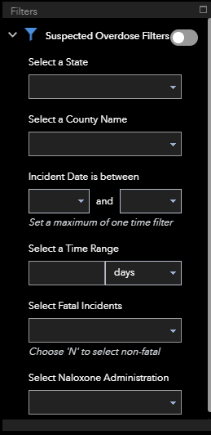
  Filtering
Suspected Overdose Filters can be
turned on and off. Green is on.
Select a State
Select a County Name
Select Incident Date is between
Select a Time Range
Select Fatal Incidents
Select Naloxone Administration

Slide 24
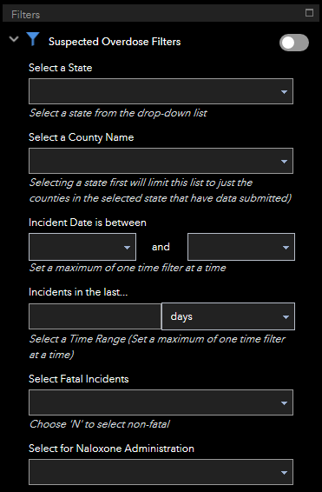

  Filtering (Cont’d)
The maximize box will maximize the screen
Clicking the maximize box
enlarges the screen
Clicking the minimize line will take you back to the dashboard

Slide 25
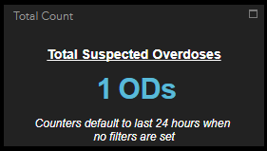
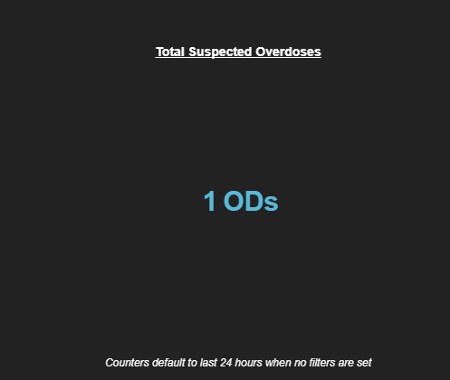
  Total Count
You can view the total count of overdoses
Expanded view using the maximize box

Slide 26
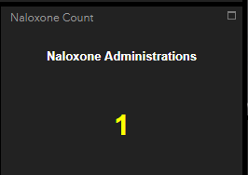
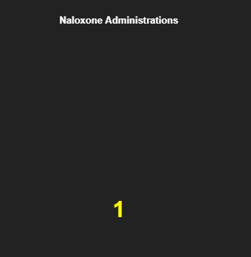
  Naloxone Administration
You can view the total number of incidents in which naloxone was administered
Expanded view using the maximize box

Slide 27
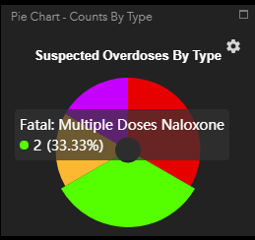
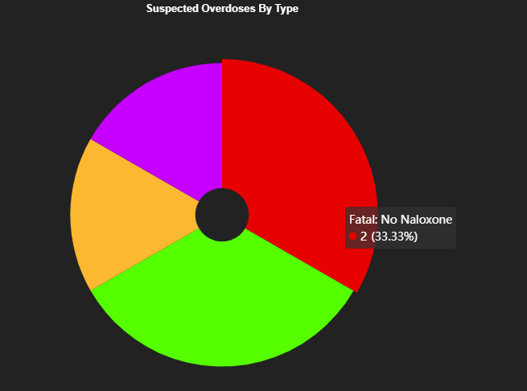
  Pie Chart
Hovering over a section of the
pie chart will display the type of OD
Expanded view using the maximize box

Slide 28
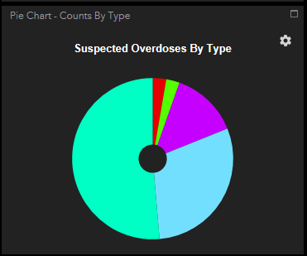
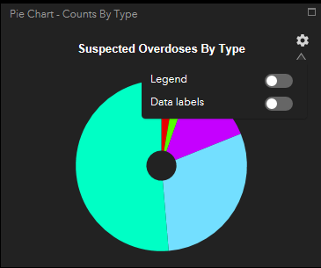
  Pie Chart Legend & Labels
Click on the icon in the upper right hand corner to toggle the legend and data labels on or off.

Slide 29
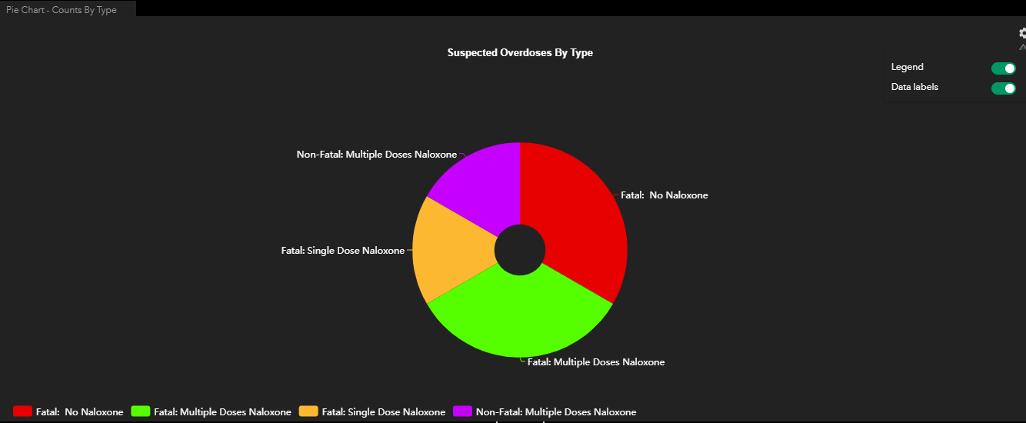
  Pie Chart Expanded View
Expanded view with the Legend and Data Labels turned on

Slide 30
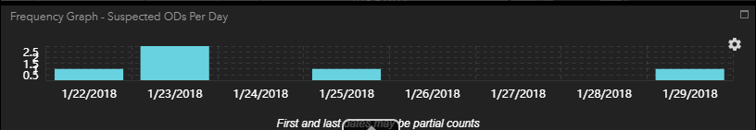
  Frequency Graph
Frequency Graph showing number of suspected overdoses per day
Depending on how time filters are set, the first and last date display may only be partial counts for that day

Slide 31
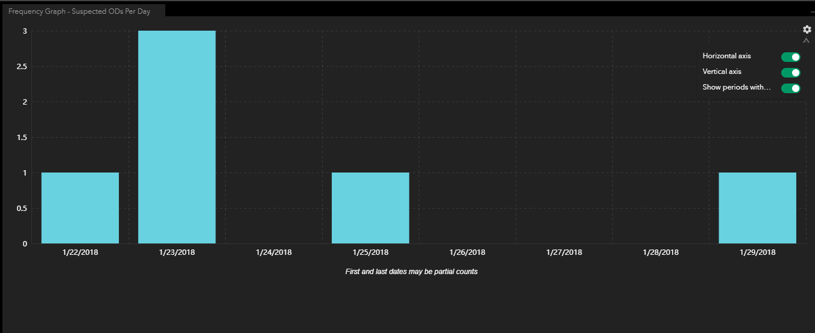
  Frequency Graph (Cont’d)
Frequency Graph showing number of suspected overdoses per day (maximized view)

Slide 32
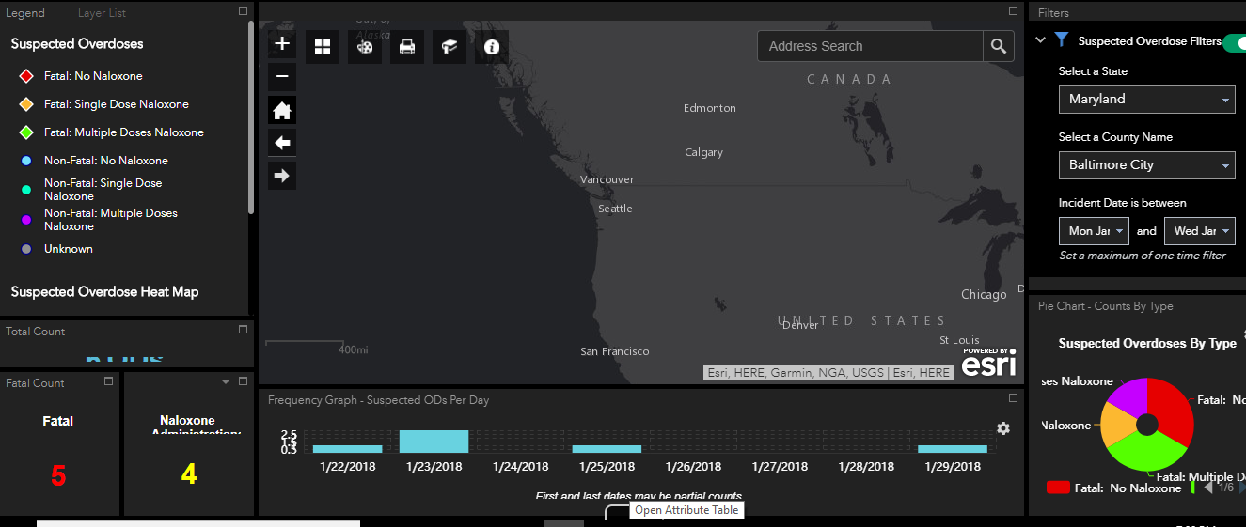
  Viewing the Attribute Table
To open the attribute (data) table click on the button below the graph.

Slide 33
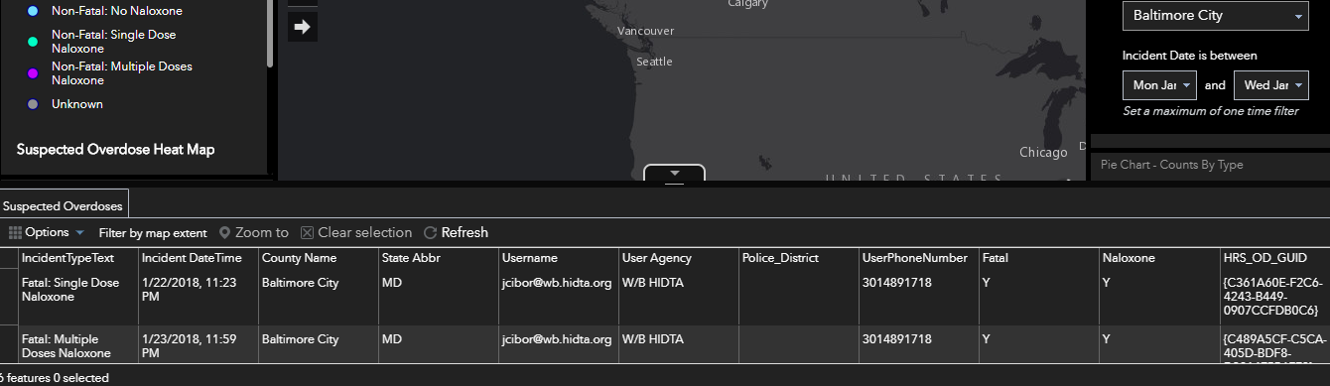
  Viewing the Attribute Table (Cont’d)
A data table will appear at the bottom of the dashboard.

Slide 34
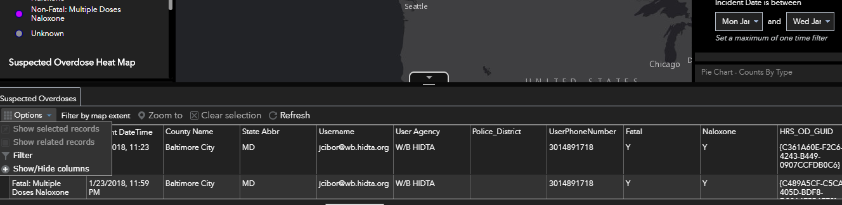
  Viewing the Attribute Table (Cont’d)
After opening the Attribute Table, you can select the Options menu to filter the columns displayed.

Slide 35
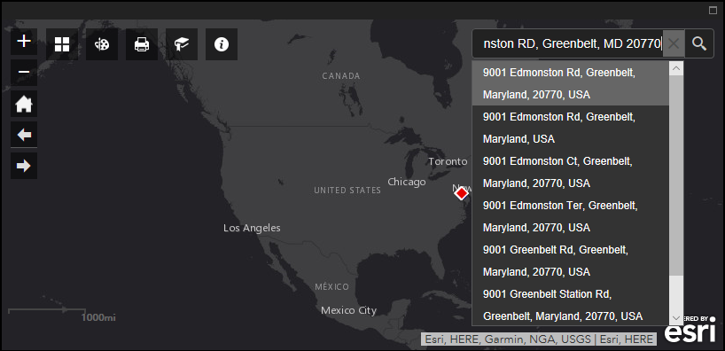
  Address Search Box
To enter an address use the Address Search box.

Slide 36
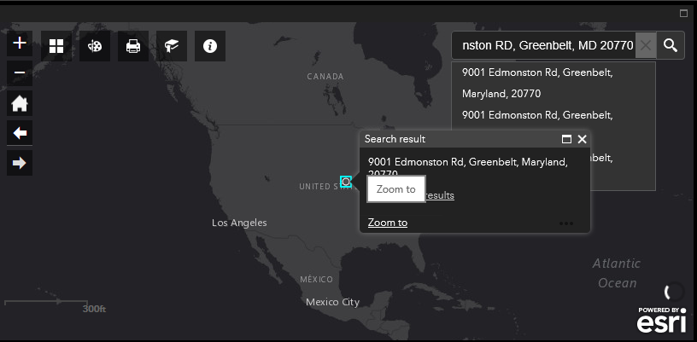
  Address Search Box (Cont’d)
To zoom in select “Zoom to”.

Slide 37
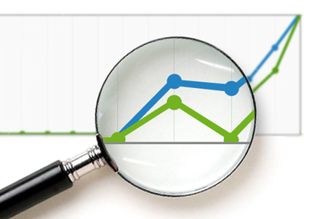
Other ODMAP Level II User
Features:
Spike alert emails
Weekly reports

Slide 38
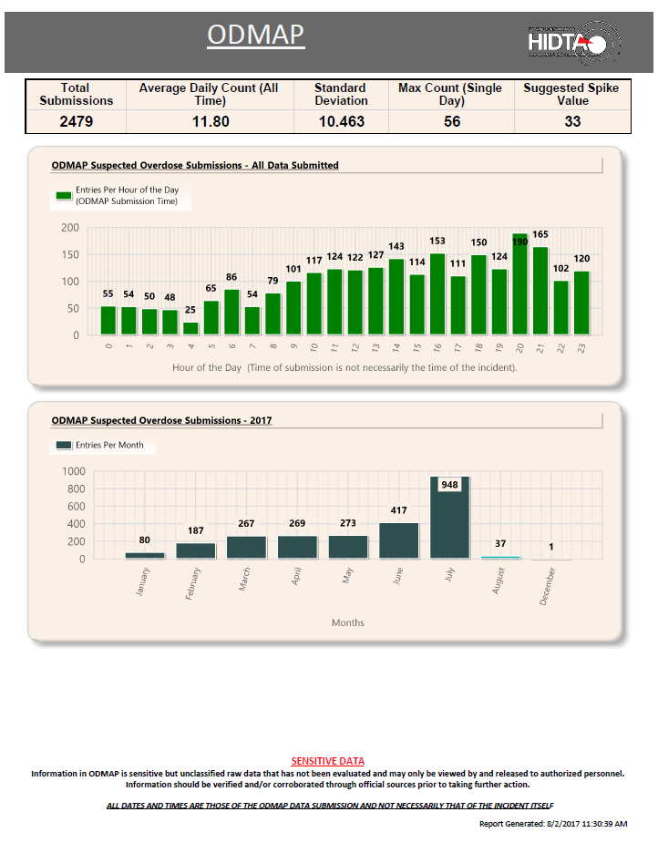
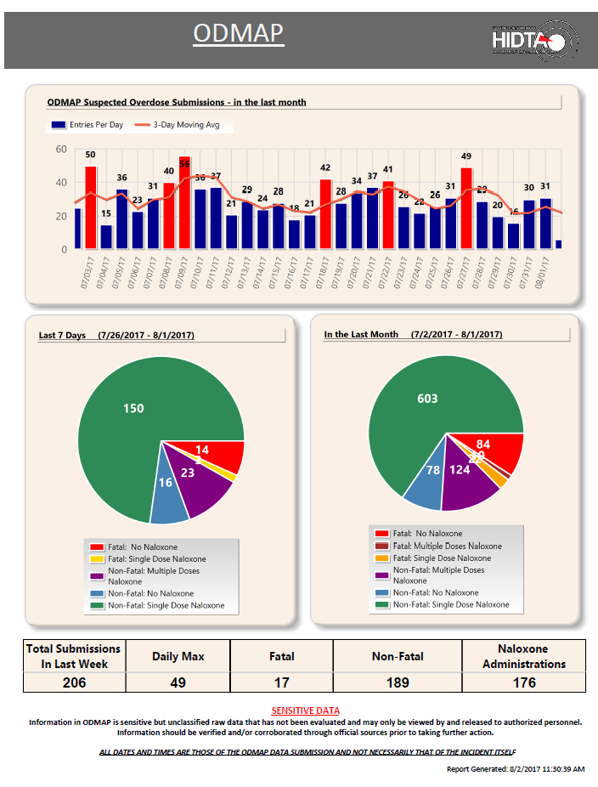
  Weekly Reports
Weekly reports are intended to provide Level II users a breakdown of data submitted to ODMAP
Level II users can receive weekly reports for their county
*Level II users can request weekly reports by contacting Deb Flores (dflores@wb.hidta.org), ODMap coordinator, once they have been both actively and consistently entering data for 30 days.

Slide 39
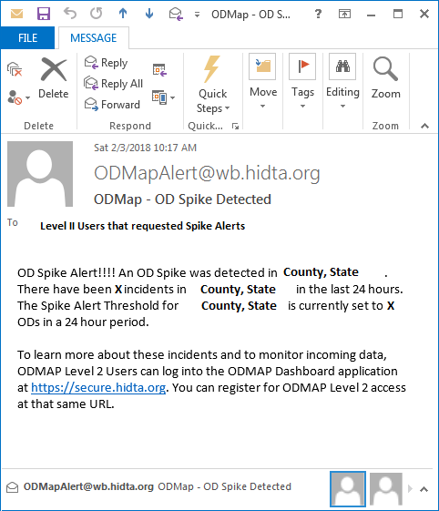
  Spike Alert Emails
Spike alerts are intended to give the public safety and public health community real time alerts to initiate response strategies.
Level II users can request spike alert emails by contacting the Help Desk.
Level II users can receive spike alerts for their county or surrounding counties.
The alerts are only useful in jurisdiction where incidents are reported in near real time.
Spike thresholds are set on a per jurisdiction basis, not on a per agency basis.
See level 1 tutorial regarding how to set-up spike alerts within the level 1 platform

Slide 40
Alternate Data
Entry Option

Slide 41

  Automated Submissions
Agencies can request automatic submissions through an API rather than having Level I Users submit data.
To request more information about automated submissions contact the Help Desk.

Slide 42


Contacts for Questions
HIDTA HELP DESK Days: Monday to Friday
Hours: 8:30 to 4:30 Est. Phone: 301 489-1744
For any questions regarding using the ODMap Program or registration, please contact:
ODMap Program Manager Aliese Alter aalter@wb.hidta.org (301) 489-1754
or ODMap Coordinator Deb Flores dflores@wb.Hidta.org 301 489-1702

